Slide 1

COOK COUNTY HEALTH
Echo Process Improvement
& Revenue Analysis
Zanib H · Nabila Baklia · Umar A
Faculty Advisor: Prof. Ranga C.
Teaching Assistant: Sonali B.

Slide 2
Project Goals
01 | WORKFLOW ANALYSIS
Analyze Inpatient and Outpatient Echo service workflows
04 | FINANCIAL PERFORMANCE
Evaluate FY 2025 financial performance of the Cardiology Echo department
02 | LEAN METHODOLOGY
Identify process improvement opportunities using Lean methodologies
05 | BILLING DISPARITIES
Identify site-specific billing disparities
03 | OPERATIONAL EFFICIENCY
Recommend operational efficiency improvements for Cook County Health
TWO CORE WORKSTREAMS
► Echo Process Improvement
► Financial Analysis

Slide 3
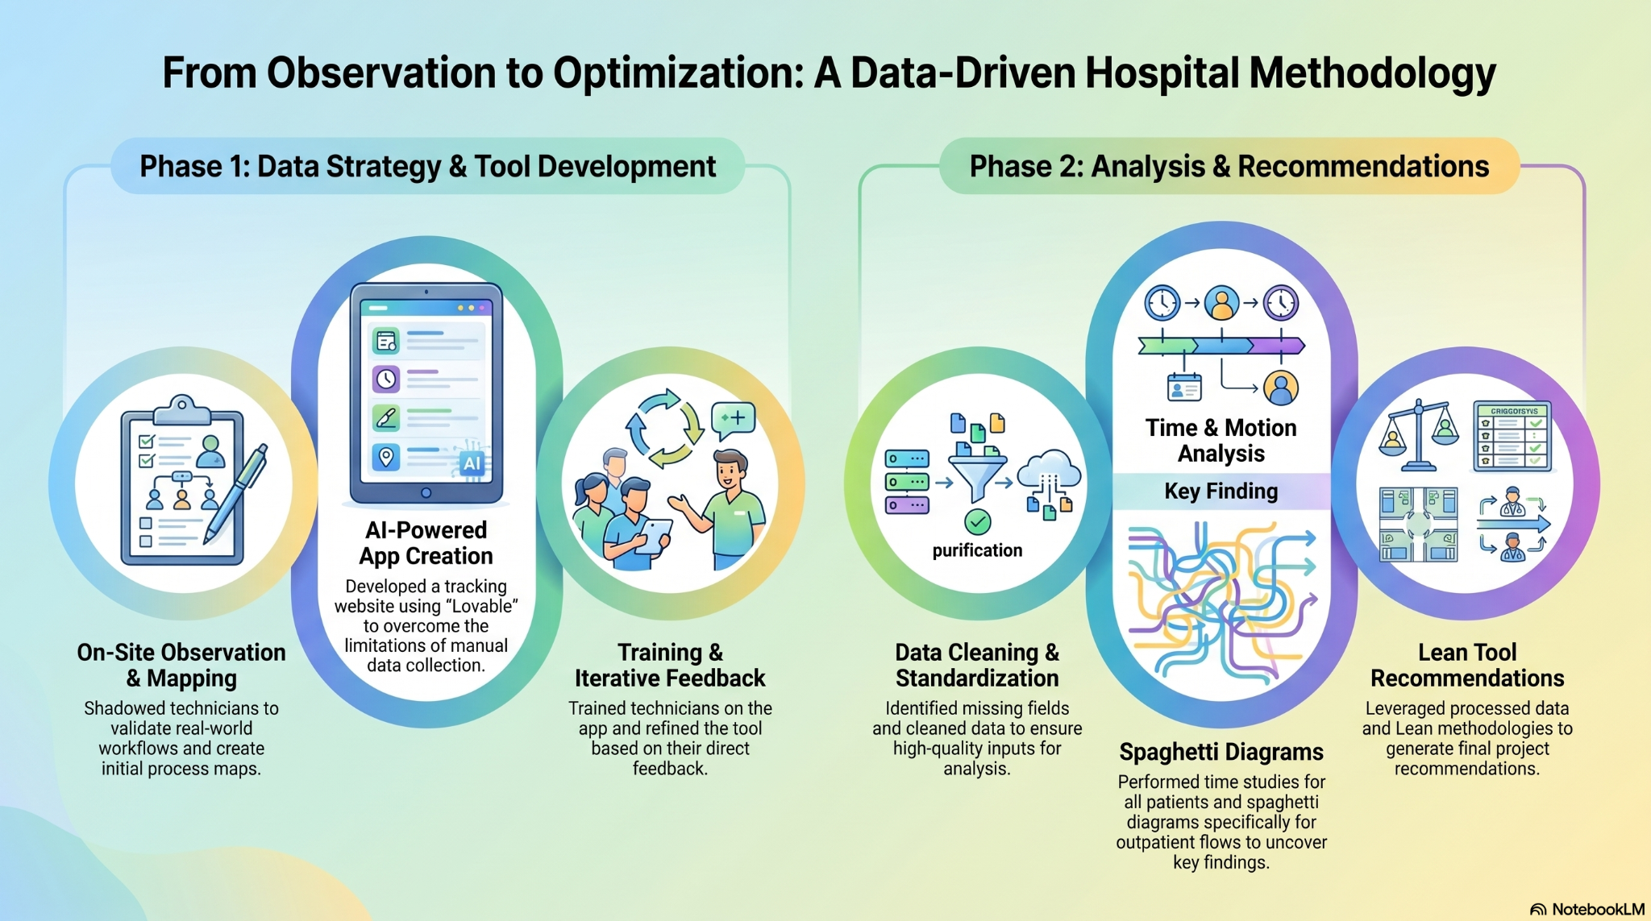
Methodology

Slide 4
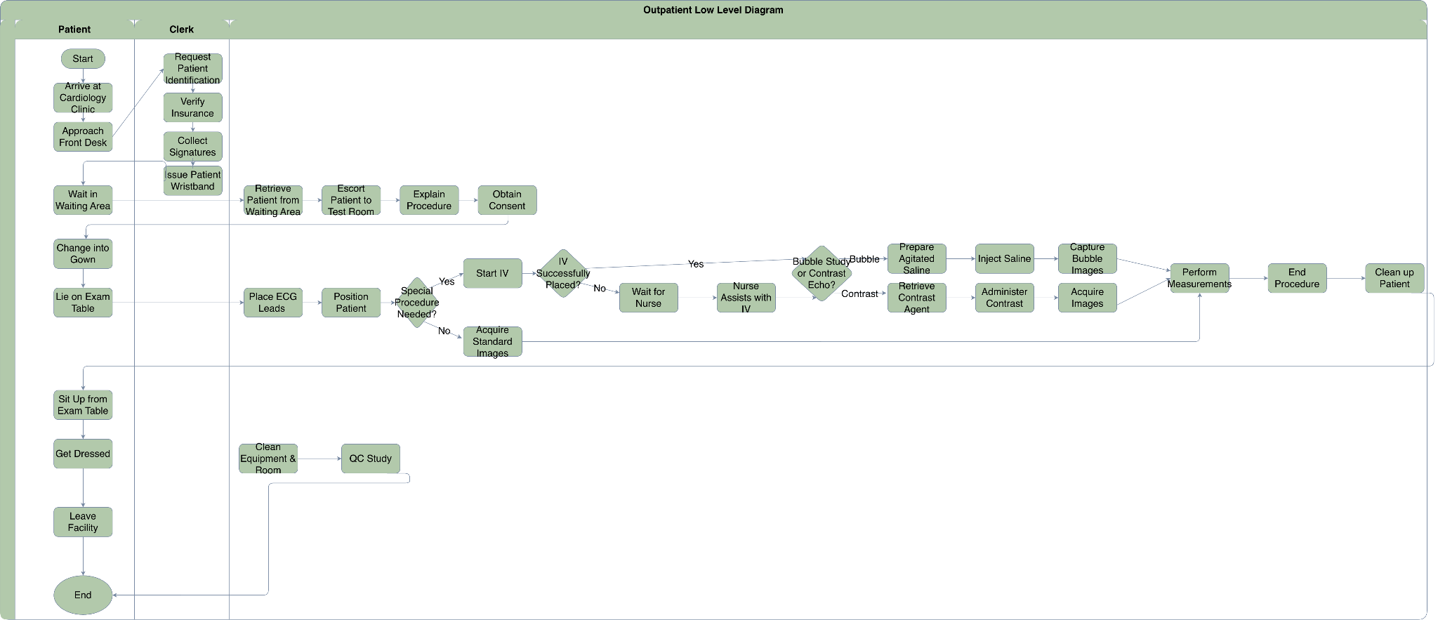
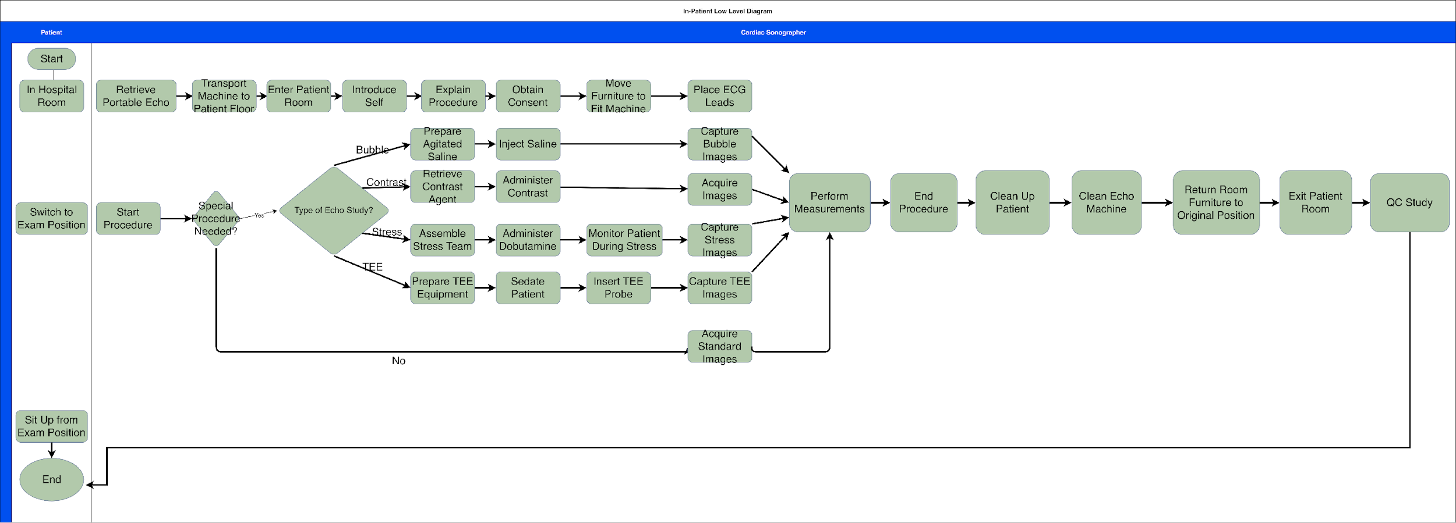
Process Maps: Out-Patient and In-Patient
04 | Out-Patient Process Map
Simpler procedures allows process to be easier to navigate
05 | In-Patient Process Map
More complex than Outpatient, more variability in exam type

Slide 5

TECH TIME TRACKER — APP DEMO
Custom mobile app deployed to Echo technologists — captures real-time timestamped durations per process step

Slide 6
Outpatient Spaghetti Diagram & Analysis
116
Avg Steps / Encounter
Per Outpatient visit tracked
28%
Encounters Over 200 Steps
Linked to room conflicts & delays
Root Causes
Check-in (62%): Workroom → Wait → Reception → Echo room every patient Rooming (32%): Southern Echo rooms add significant distance per trip Bathroom detours: 60–100 extra steps, no clinical value Workroom 2831 isolated at far east wall — every supply trip crosses full floor

Slide 7
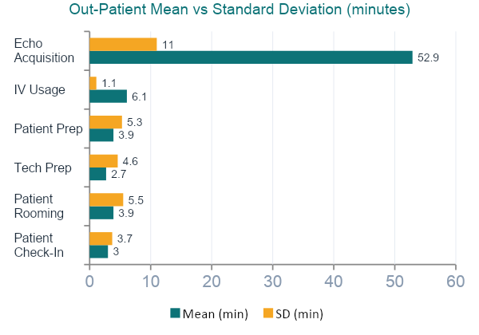
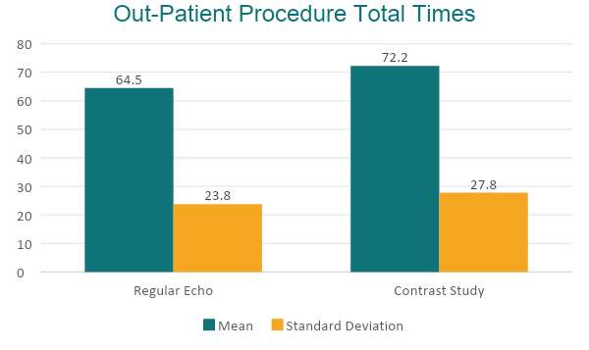
Procedure Level Analysis— Outpatient
Patient Rooming max = 48.3 min (vs mean 3.9 minutes) — caused by room conflicts with patients that need Holter monitors
IV Placement delay accounts for 46% of all Outpatient delay events (12 of 26 flagged records)
Tech Prep outliers were driven almost entirely by Imaging software login failures (max 31.2 minutes vs. mean of just 2.7 minutes)

Slide 8
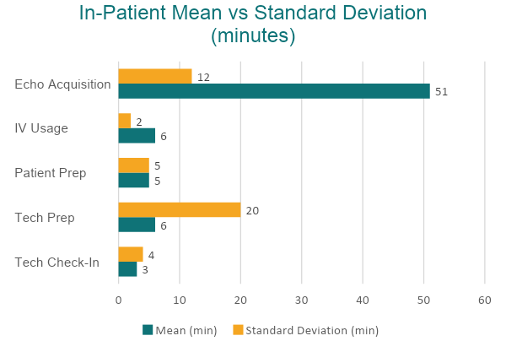
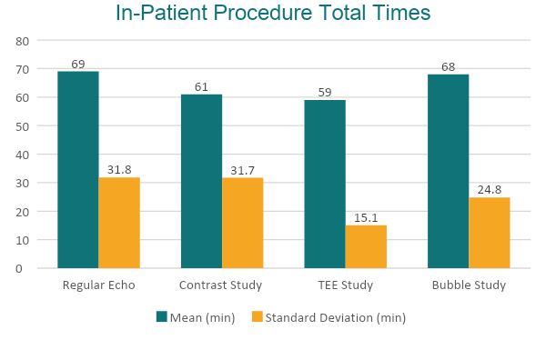
Procedure Level Analysis— Inpatient
Tech Prep is the most critical step: Mean: 6 minutes but Standard Deviation of 20.2 minutes
The bottleneck is floor travel without confirming patient availability

Slide 9
Lean Waste Identification — TIMWOODS Framework
Waiting - Inpatient: 35% / Outpatient: 64%
Nurse unavailability
IV delays
Patient restroom break
Room conflicts
Driven by lack of pre-scheduling
Transportation - Inpatient: 26% Outpatient: 4%
Elevator delays, Tech walking to Patients Floor, Repeated travel
Image transfer between systems
Room conflicts
Fragmented workflow design
Skills - Inpatient: 9% / Outpatient: 14%
Tech assisting food trays
Pulled away for other patients
Restroom help
QC during patient time
Unclear role boundaries
Defects - Inpatient: 9% / Outpatient: 11%
Imaging Software login failures
Incorrect order types
Machine crashing
IT instability in software
Inventory - Inpatient: 6% / Outpatient: 0%
Optison/contrast agents not pre-stocked
Bubble study supplies not ready at scan start
No standardized protocols
Motion - Inpatient: 6% / Outpatient: Spaghetti
Repeated corridor travel between workroom & Echo rooms
No standardization travel sequence
Unnecessary steps due to lack of coordination

Slide 10
Recommendations
R1
Patient Ready Confirmation Call
R5
Pre-Scan Restroom Prompt (All)
Call in-patient floor before departure
Fixes: Patient not in room / unavailable
Cuts prep time 6.6 → 2.4 min; IP echo ~58-62 min.
IMMEDIATE
IMMEDIATE
Prompt patients before scan
Fixes: Mid-exam interruptions
Removes 3 - 5 min delays
R2
Nurse Pre-Notification Protocol
R6
Shift-Start 5S Supply Checklist
IMMEDIATE
Alert nurse before tech arrival
Fixes: nurse, unavailable, IV delays
Tech Prep 6.1 → 3 min
IMMEDIATE
Standardize supply checklist before starting procedures
Fixes: Supply retrieval delays
Removes 3-10 min delays
R3
Imaging Software IT Fix — Session Persistence
R7
Room Pre-Assignment with Conflict Check
IMMEDIATE
Fix login crashes & implement auto-save every 5 minutes
Fixes: 5-10 min system delays
Eliminates 5–10 min crashes per affected visit
STRUCTURAL
Assign rooms & check conflicts early
Fixes: Rooming delays (Holter overlap)
Rooming: 48.3 min max → 2.4 min median
R4
IV Pre-Placement for Out-Patient Contrast
R8
Provident Transport Protocol
IMMEDIATE
Place IV before echo begins
Fixes: 46% of outpatient IV wait
Outpatient contrast: 72.2 → 62–67 min
STRUCTURAL
Optimize transport workflow
Fixes:Close 17-min gap vs Stroger
Total Time: 78 → ≤ 65 min

Slide 11
Time Savings after Lean Implementation
Procedure | Path | Current Mean (Total Time) | Target Range (mean) (Forecasted Total time) | Time Saved
Regular Echo | In-Patient | 68.7 min | 58 – 62 min | ▼ 7–11 min
Contrast Study | In-Patient | 61.0 min | 55 – 60 min | ▼ 5–10 min
TEE Study | In-Patient | 59.0 min | 50 – 55 min | ▼ 5–9 min
Bubble Study | In-Patient | 68.3 min | 60 – 65 min | ▼ 3–8 min
Regular Echo | Outpatient | 64.5 min | 62 – 67 min | ▼ 5–10 min
Contrast Study | Outpatient | 72.2 min | 62 – 67 min | ▼ 10–16 min

Slide 12
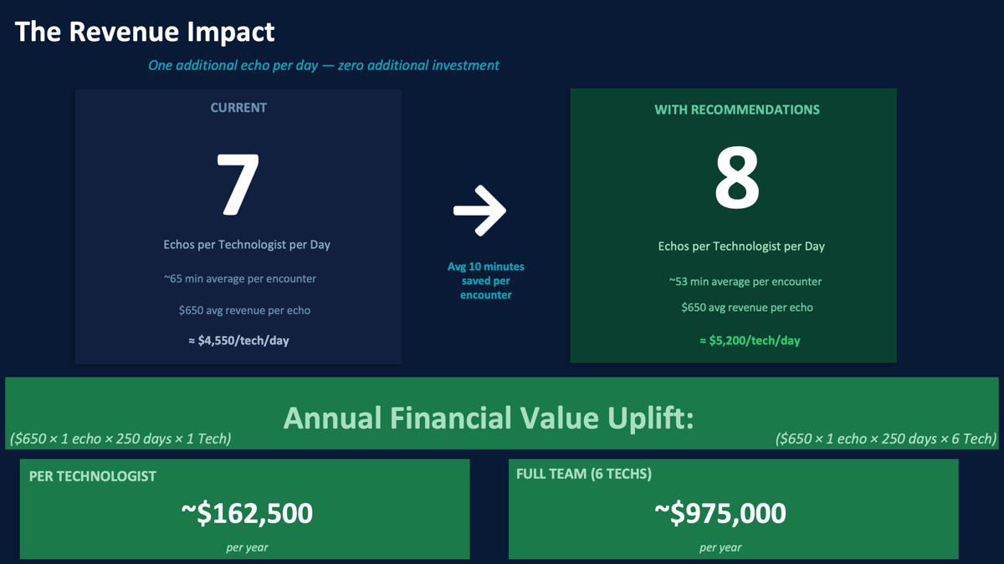

Slide 13
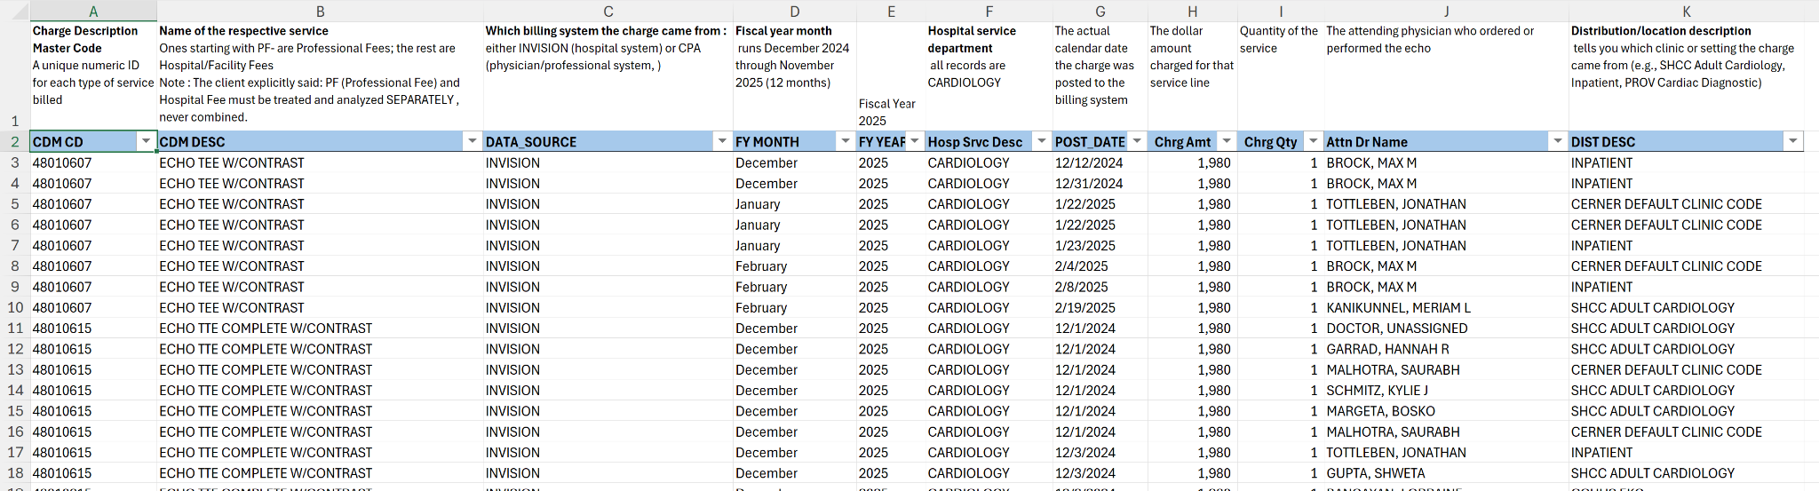
Financial Analysis FY 2025 - Echocardiology
Snippet of the data provided to us:

Slide 14
Charge & Volume Architecture
Metric | Hospital (Facility) Fee | Professional Fee |  | Total
Total Charges | $5,933,187 | $933,893 |  | $6,867,080
Total Volume (Qty) | 4,262 (43%) | 5,727 (57%) |  | 9,989
Average Charge per Service | ~$1,392 | ~$163 |  | $687
Charges Contribution | 86.00% | 14.00% |  | 100%
While Professional Fees account for 57% of the record volume (5,727 records), they only drive 14% of the charges. This is due to the disparity in average charge per record

Slide 15
Services Concentration
Procedure | CPA | INVISION | CPA Count | INVISION Count
ECHO TTE COMPLETE W/CONTRAST | $288,081 | $4,575,454 | 181 | 2888
PF-ECHO TTE W/CONTRAST | $29,556 | $489,599 | 174 | 2882
ECHO TEE (TRANSESOPHAGEAL) | No Charges Recorded | $299,155 | 0 | 213
ECHO REST & STRESS W/PF | No Charges Recorded | $189,901 | 0 | 135
ECHO TTE LIMITED W/CONTRAST | $9,761 | $173,025 | 14 | 239
ECHO 2D W/W/O M-MODE LTD | $29,274 | $129,128 | 47 | 208
ECHO DOBUTAMINE STRESS ONLY | No Charges Recorded | $93,833 | 0 | 67
ECHO TEE CMPL W/PF | No Charges Recorded | $78,586 | 0 | 56
PF-ECHO TRANSTH W/DOPPLER COM | $95,844 | $166,227 | 564 | 978
PF-ECHO TEE (TRANSESOPHAGEAL) | No Charges Recorded | $69,420 | 0 | 265
Certain procedure types do not have a corresponding charge in CPA for PF fees - no 1:1 ratio

Slide 16
Location-Wise Charge Distribution
Location | Total Hospital Charges | Total Professional Charges
SHCC ADULT CARDIOLOGY | $ 4,348,717 | $ 605,020
INPATIENT | $ 973,308 | $ 132,847
PROV CARDIAC DIAGNOSTIC | $ 326,165 | $ 127,561
CCHHS EKG | $ 30,389 | $ 35,273
CERNER DEFAULT CLINIC CODE | $ 243,940 | $ 31,837
SHCC ADULT ER | $ 6,399 | $ 848
CCHHS CARDIOLOGY | No Charges Recorded | $ 169
Core Cardiology Clinic | No Charges Recorded | $ 169
SSC CARDIOLOGY | $ 4,269 | $ 169
SHCC Adult Cardiology serves as the primary operational hub, responsible for the vast majority of both facility and professional revenue.
The Inpatient setting represents the second-largest revenue source, emphasizing the department's critical role in acute care diagnostics.
Additionally, you will see Professional charges are there, but no hospital charges recorded for the respective location.

Slide 17
Key Findings Summary
1
Waiting is the #1 Waste in Both Pathways
2
Imaging Software Failures Add 5–10 Min Per OP Encounter
3
IV Placement = 46% of All OP Delay Events
4
Lean Implementation: +1 Echo/Tech/Day
FY 2025 Financial Snapshot — Echocardiology
$6.87M
$4.86M
9,989
–17 min
Total Charges
Top Procedure
Total Encounters
Stroger vs Provident
$5.93M facility + $933K professional
ECHO TTE Complete w/ Contrast
86% of all facility charges
4,262 hospital (43%)
5,727 professional (57%)
Provident averages 17 min longer
Site-specific transport protocol needed

